Slide 1
Lesson 2
Network Representation and Basic Characterization

Slide 2
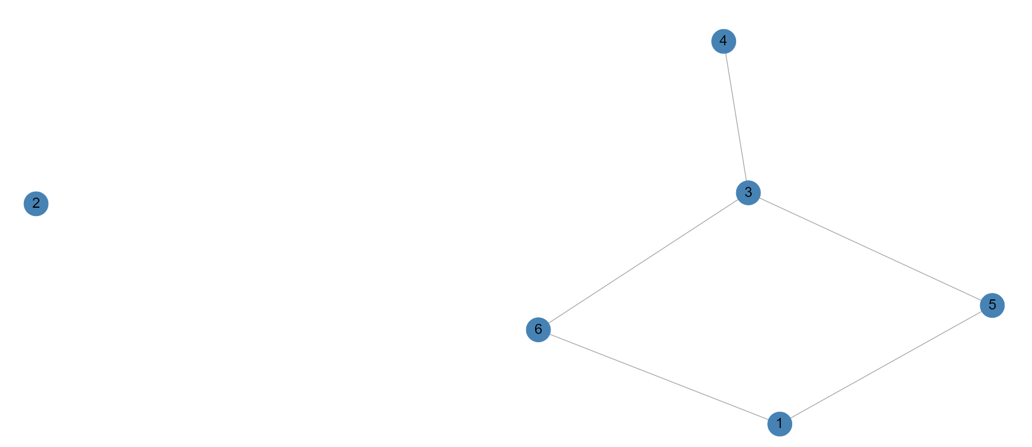
Network
Networks are represented using graphs where the nodes or vertices of the graph denote people or other entities, and the edges or ties denote connections between the nodes. Technically, graphs and networks are not mathematically equivalent; however, they will be for this course.
vertex
edge

Slide 3
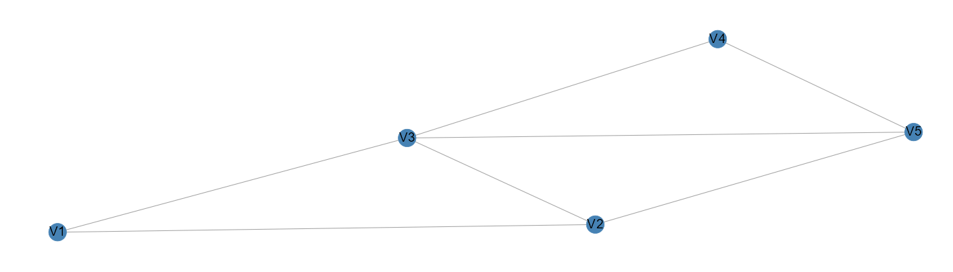
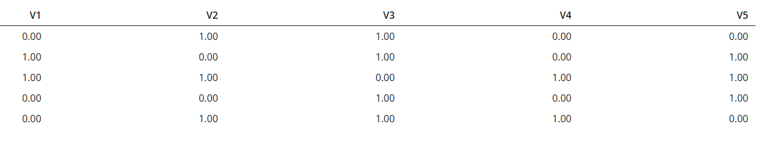
Representing Networks
Adjacency Matrix

Slide 4
Representing Networks
Degree = the number of edges incident to a node
deg(V2) = 3 deg(V4) = 2

Slide 5
Representing Networks
Networks are generally given a name such as the letter g, the row numbers are denoted by the letter i, and the column numbers by the letter j. We can, therefore, say the g_{ij} = 1 if nodes i and j are linked. In multigraphs, g_{ij} = 3 would indicate that there are three ties between i and j. In weighted graphs g_{ij} = p where p represents a weight of the connection between node i and node j.
An alternative way to represent a network is using a list; for instance, the network of the previous slide represented as a list could be represented as g = {{1,2}, {1,3}, {2,3}, {2,5}, {3,4}, {3,5}} or even g = {12, 13, 23, 25, 34, 35}
This list is called an edgelist; however, one needs to be careful when using an edgelist to describe a graph as isolates (nodes with no connections) will not appear in an edgelist so these vertices will be lost if this is the only data structure describing the graph.

Slide 6
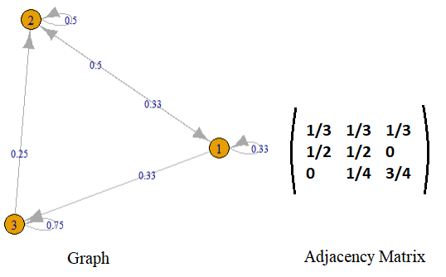
Weighted Networks
A weighted network puts weights on the edges between its nodes
An interesting observation about the adjacency matrix is that all of the weights are non-negative and each row adds up to 1, i.e., ∑_{j} g_{ij} = 1. Such networks are called row stochastic networks

Slide 7
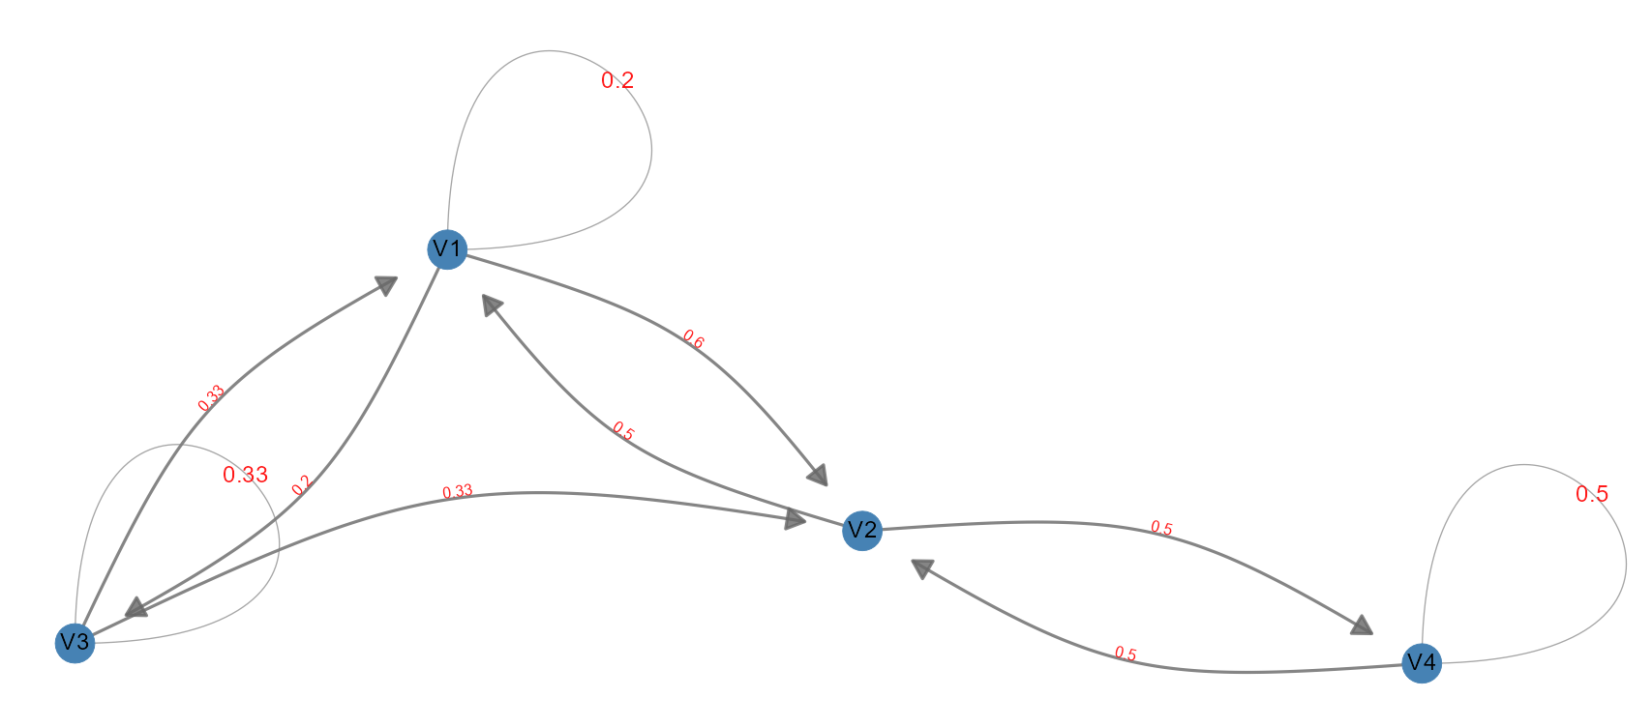
Weighted Networks

Slide 8
Properties of Weighted Networks
In-degree → How many “followers”
Out-degree → How many “following”
Reciprocity → Bidirectional ties

Slide 9
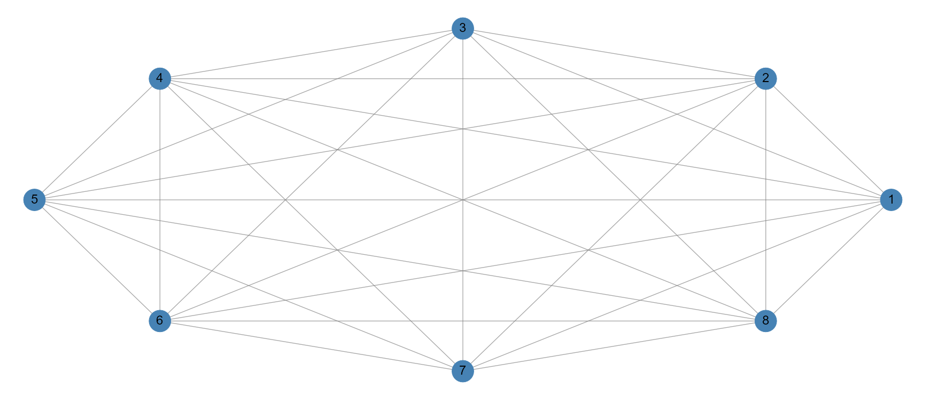
Complete Graph
A complete graph is a graph where every vertex is incident to every other vertex.
The complete graph for any order of graph is used to help determine density. Notice that for a graph of 8 vertices, each has degree = 7. How many edges are there total?

Slide 10
Characterizing Networks (1)
Global patterns give us the big picture of the overall network
Segregation patterns, on the other hand, allow us to look at the attributes of the nodes - such as the age, gender, or race of individuals - and see if nodes are segregated based on these attributes or if they are fairly well integrated
Local patterns allow us to identify configurations such as tight clusters of nodes or cliques, transitivity (where, if one node is connected to the other and the other is connected to a third node, then the one is also connected to the third node), and support where relationships have friends in common

Slide 11
Global Statistics
In traditional statistics, the 5 number summary characterizes the data:
Minimum
25% (Q1)
Median (Q2)
75% (Q3)
Max
In Graphs, we use a different set of statistics to describe the general features of the network
Size
Components
Isolates (and proportion of isolates)
Density
Diameter
Average Path Length
Compactness (Future Lectures)
Clusters (Future Lectures)
Centralization (Future Lectures)
...

Slide 12
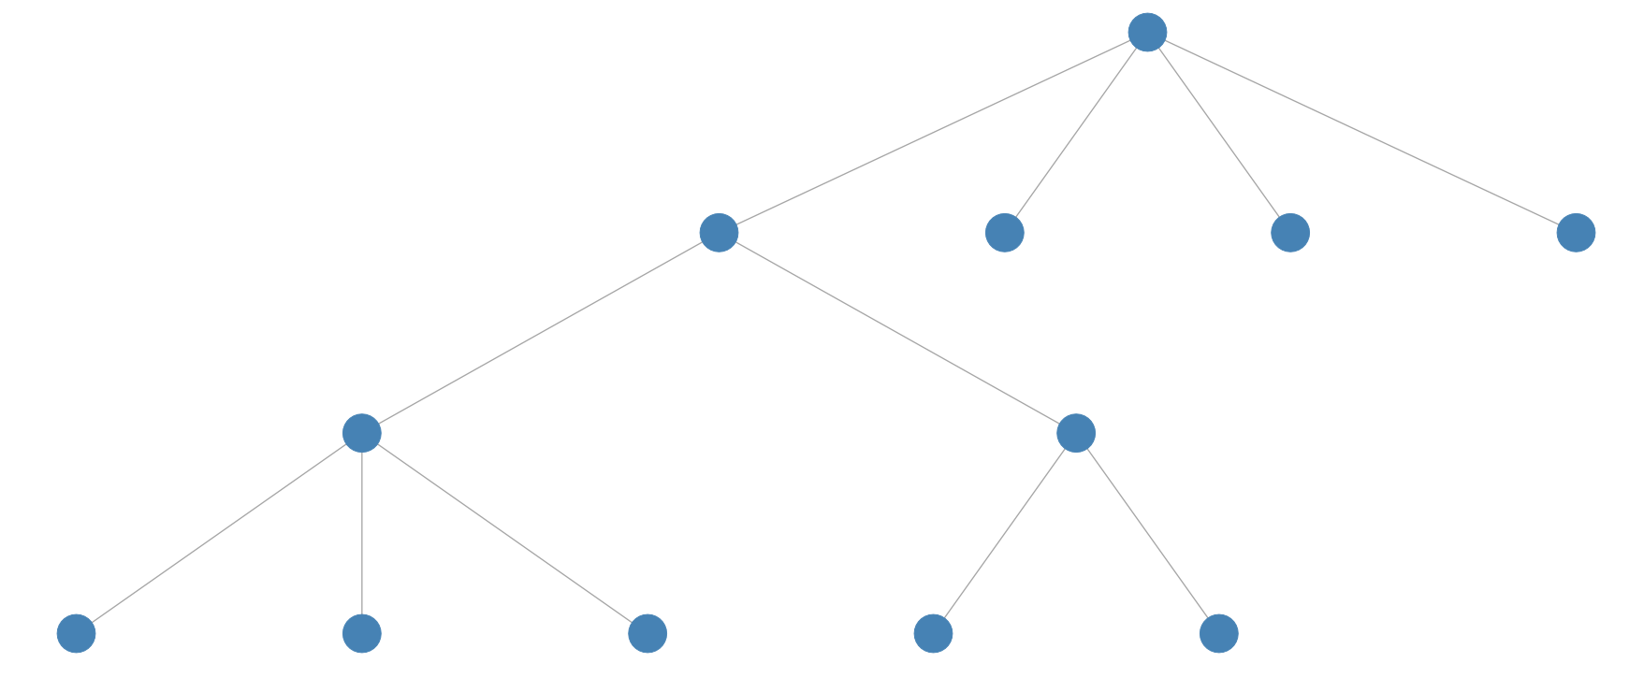
Size
Size is simply the cardinality (total number) of vertices within a network. (The tree network provided here has size 12)

Slide 13
Components
Components are connected subgraphs that make up a network
We say that a network (N, g) is connected if there is a path between every pair of nodes in the network
A component, therefore, is a maximal connected subgraph in a network, i.e., a component (N’, g’) is a subset of a network (N, g), (N’, g’) is connected, and for every i in N’ if ij in g then j in N’ and ij in g’.

Slide 14
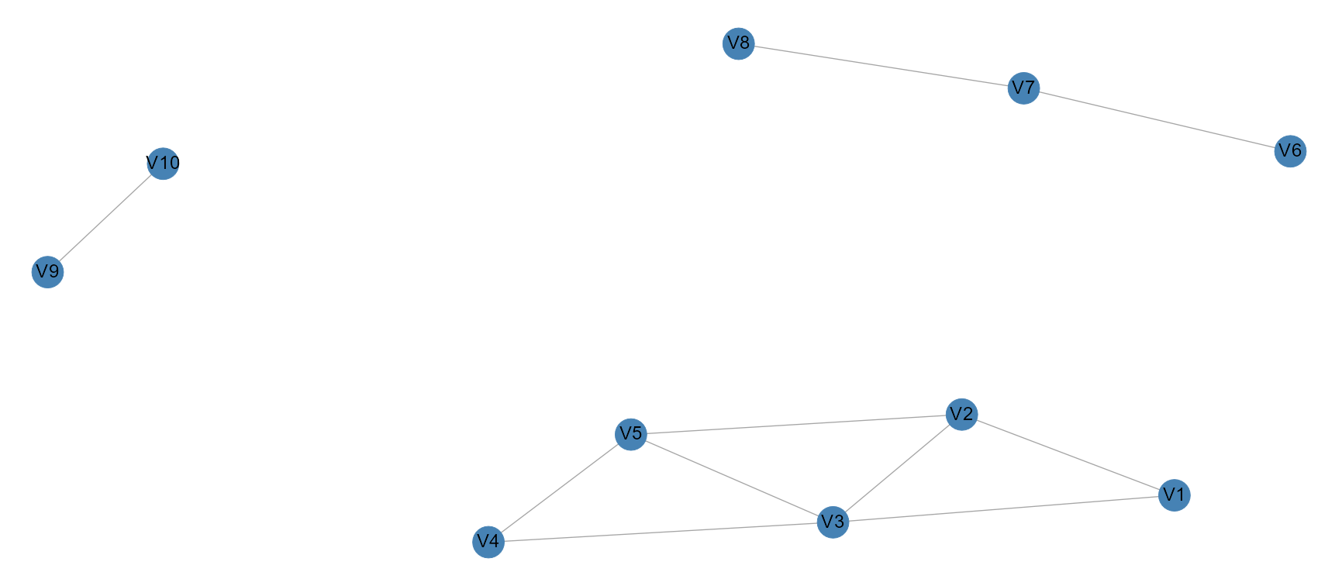
Components

Slide 15
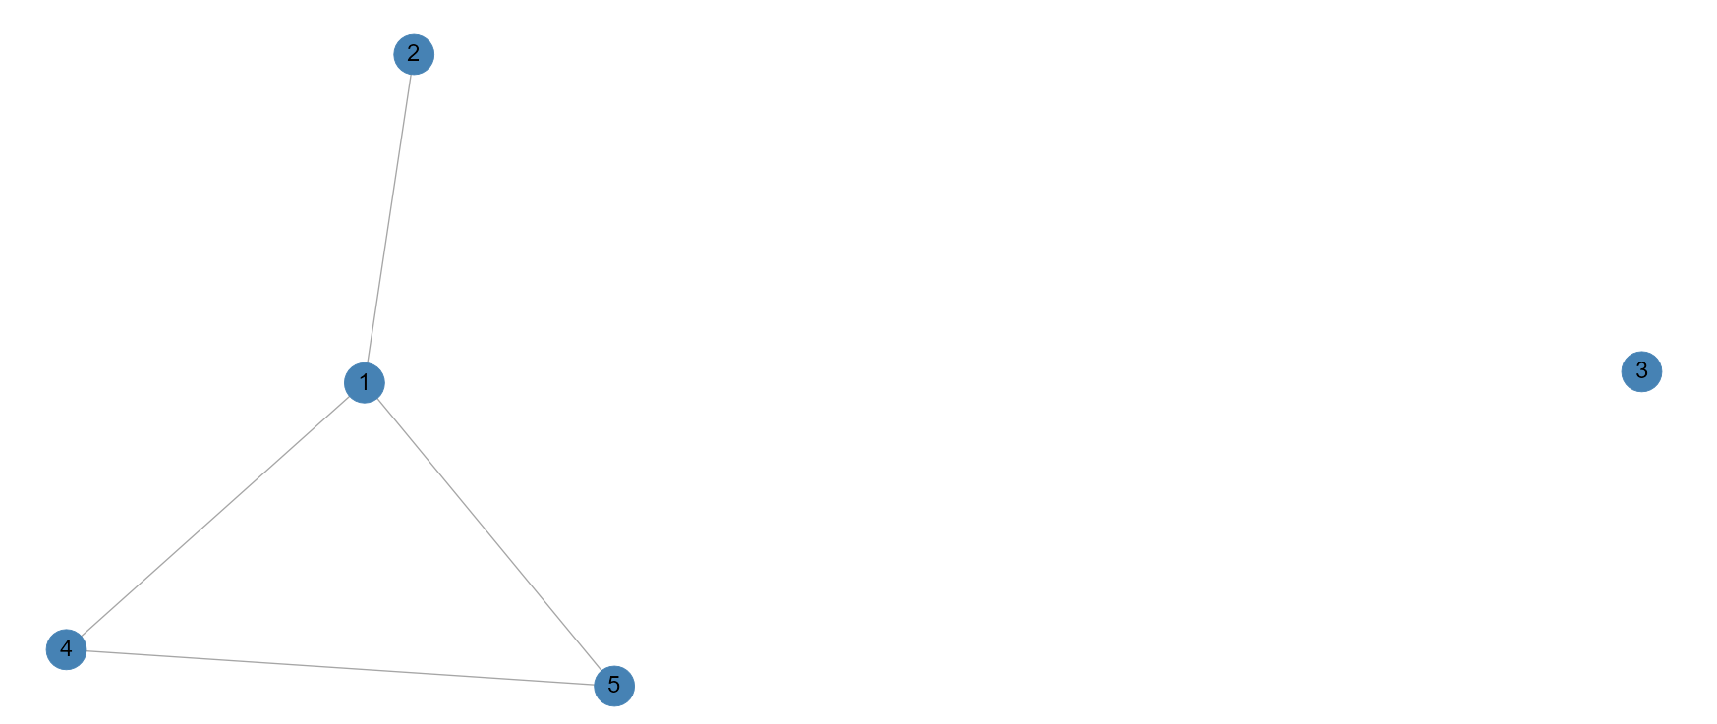
Isolates

Slide 16
Density
Density is a measure of how many edges are in the graph when compared to the maximum number of edges. Let L be the number of edges and k be the number of nodes.
In a directed graph:
In an undirected graph with no loops:
$Density=\frac{L}{kx\left(k−1\right)}$
$Density=\frac{2L}{kx\left(k−1\right)}$

Slide 17
Terminology
In order to be able to identify these patterns, we need to develop some fundamental measures that would help uncover them
A walk from a node i₁ to i_{k} is a sequence of nodes (i₁, i₂, …, i_{k}) such that i_{k}-₁i_{k} in g for each k
A walk may be a path (i₁, i₂, …, i_{k}) with each node i_{k} distinct or
A walk may be a cycle where i₁ = i_{k}; a cycle, therefore, is a walk that loops back to the node from where it started
A geodesic is a shortest path between two nodes where the path between the two nodes is measured counting the number of links

Slide 18
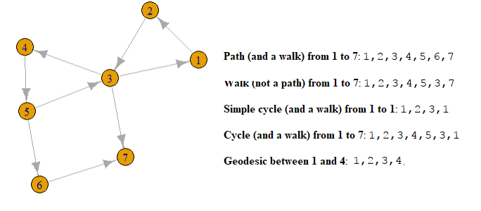
Example

Slide 19
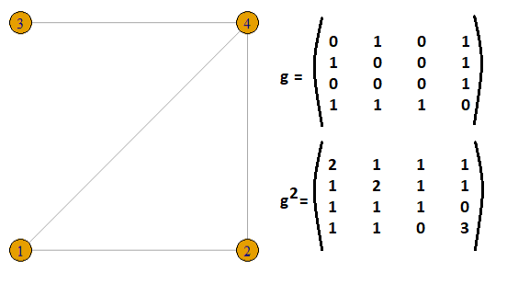
Counting the number of walks

Slide 20
Network Diameter
Diameter is the largest geodesic (or the largest shortest path) in the network; if the network is not connected, then we can take the diameter of the largest component
Diameter can be prone to outliers when most of the nodes in the network are fairly close but only a few lie far apart; in such cases a better measure may be the average path length which is the average geodesic of the network

Slide 21
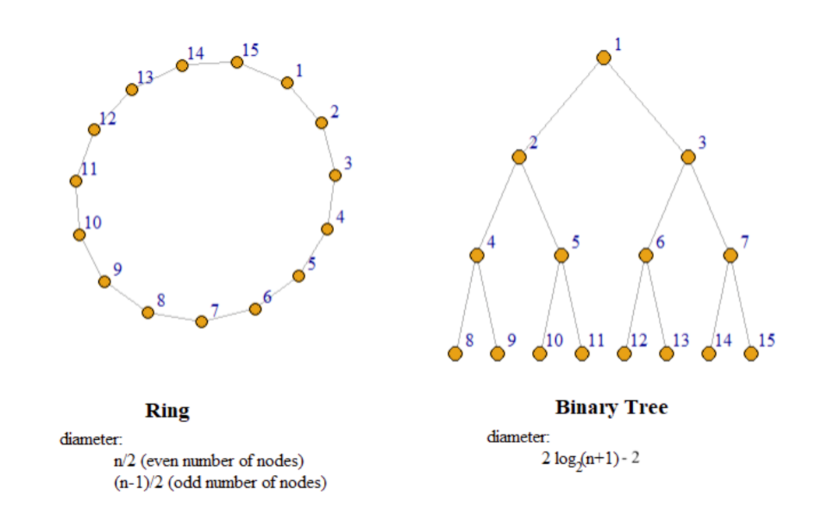
Example
Diameter and average path length play an important role in determining how long it would take to reach a node on an average and how fast information can spread within a network

Slide 22
Neighborhood
Neighborhood of a node i in a graph g is defined as a set of all those nodes in g that are directly linked to i, i.e., N_{i}(g) = {j | ij in g}
The degree of a node i in graph g is the cardinality of N_{i}(g), i.e., d_{i} = # Ni(g)

